Slide 1




Project Wireframes
Problem statement and
solution proposal

Slide 2
Outline
The Problem
Solution Proposal
Wireframes
Next Steps

Slide 3
The Problem

Slide 4
Problem statement
State the problem you are solving in one or two sentences.
Make sure to explain why it is a real problem.

Slide 5
What customers do today
Justify your effort to try to solve the problem.
Highlight the pain points of the current solution or how customers deal with not having a solution to the problem.

Slide 6
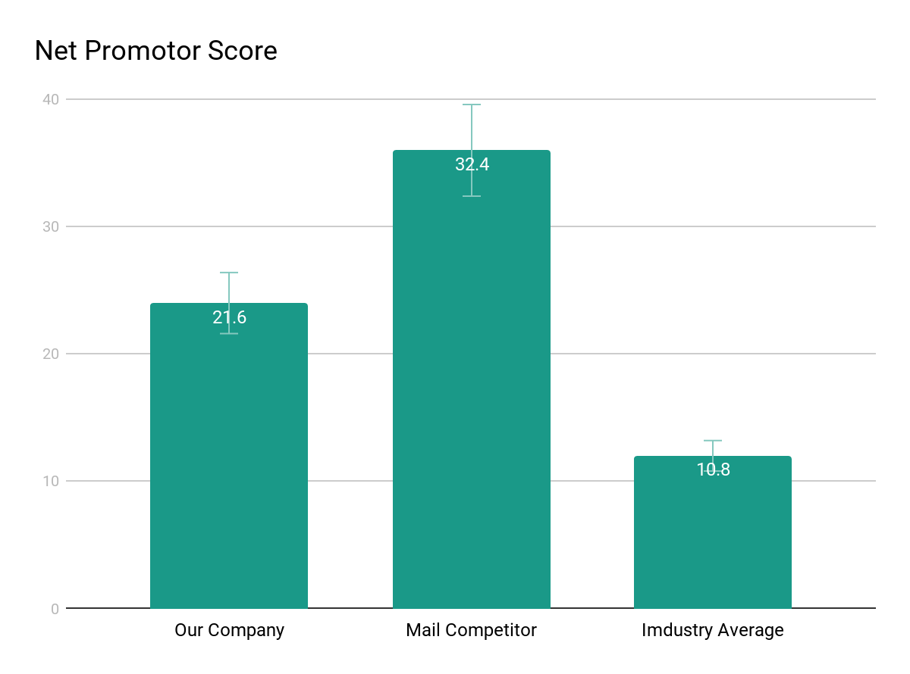
Supporting information
01
1
List any research or data you have to support the need for a solution.

Slide 7
Supporting information
02
82%
Users are constantly searching for a solution
Explain why you’re focusing on a particular part of the problem or a particular subset of users.

Slide 8

Supporting information
03
Julia
Team Manager
Reference your personas, if you have them.
Describe the content of Julia’s job and the problem she and her team are currently facing.

Slide 9
Use cases / user stories
Use cases, user stories, notes to set up the wireframes. Such as…
“As an Administrator, I would like to restrict permissions based on role.”
“As a Moderator, I would like to flag and approve comments.”
Executives indicated that being able to see a summary of each segment of data was their #1 priority.
Note: secondary admin workflow not planned for this release.

Slide 10
Assumptions
State your assumptions or any unknowns here.

Slide 11
Solution Proposal

Slide 12
Solution description
Now that you’ve justified your attention to the problem, summarize your solution in one or two sentences.

Slide 13
Why it’s better than existing solutions
Return to the problem now that you’ve introduced your solution. Compare your solution to others and describe how it is superior.

Slide 14
Wireframes

Slide 15
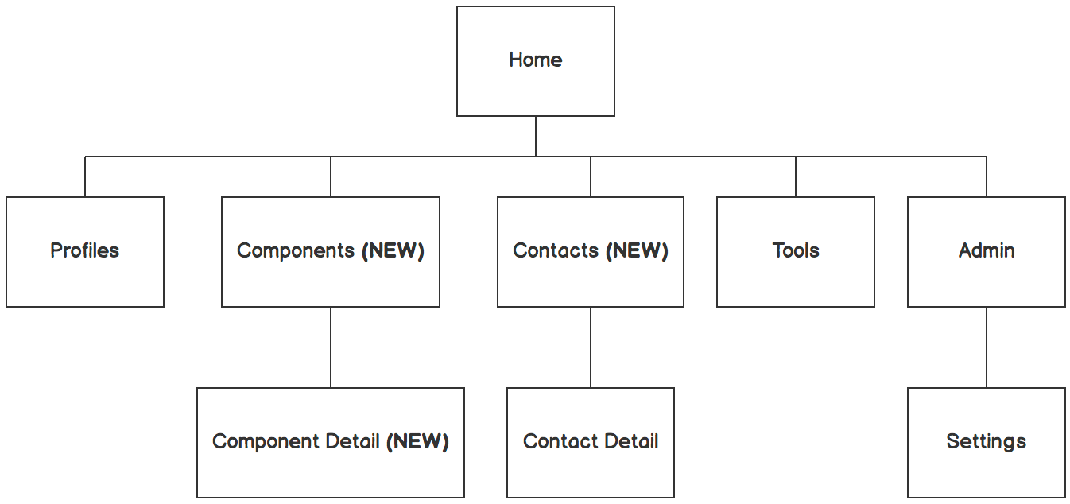

Information architecture
Balsamiq Tip | Information architecture is the flow of content across the site or application (more info).

Slide 16
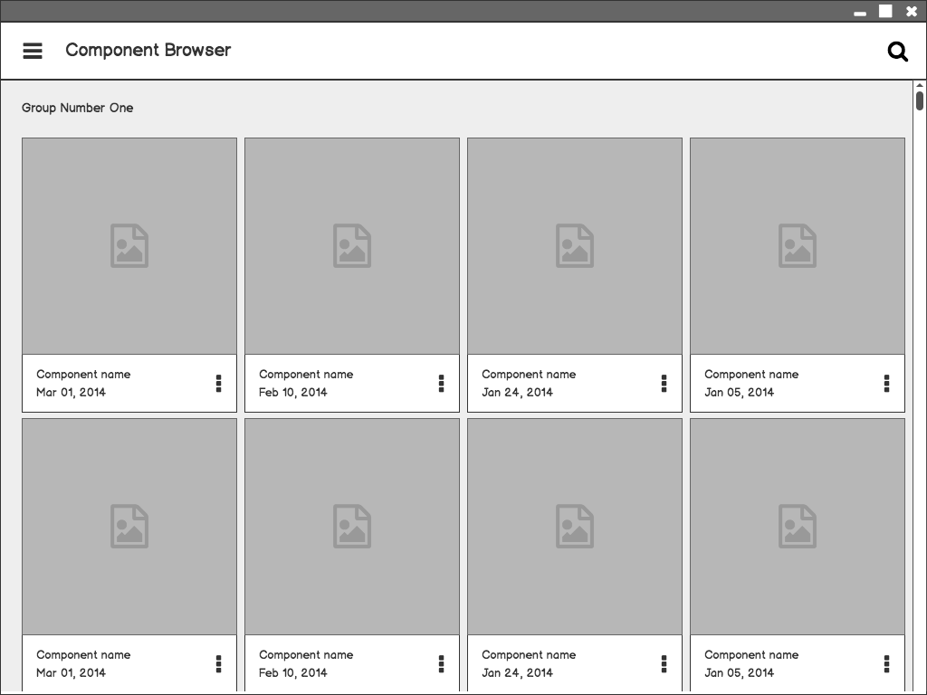
Component Browser
Call out key parts of the UI
Balsamiq Tip | Use the Balsamiq add-on to make your own wireframe.

Slide 17
Component Detail

Slide 18
Component Detail (Mobile)
Articulate your design decisions by adding justifications

Slide 19
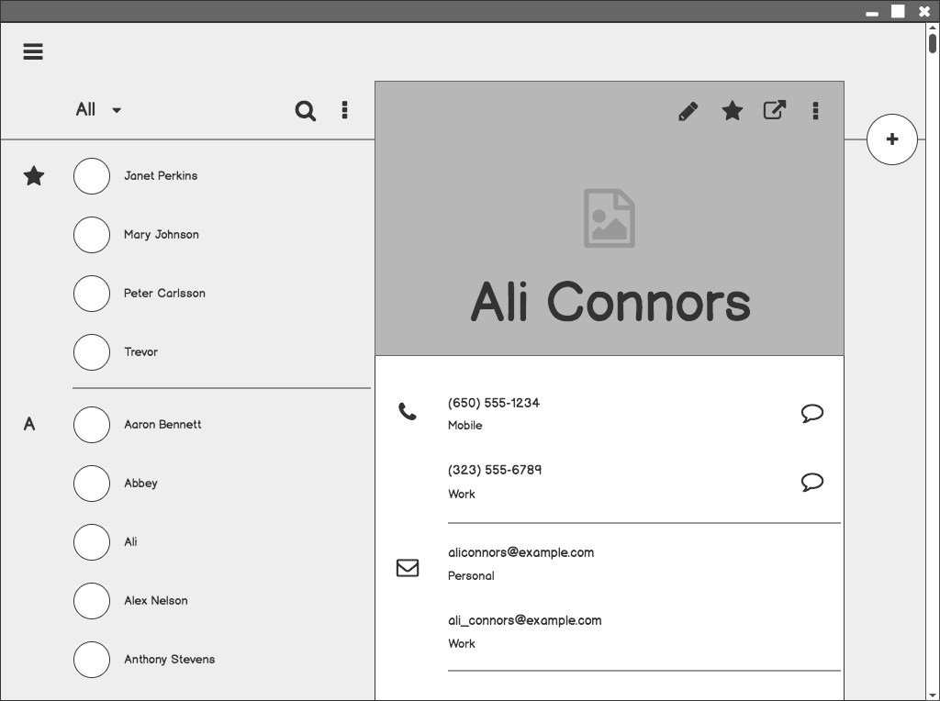
Contacts

Slide 20
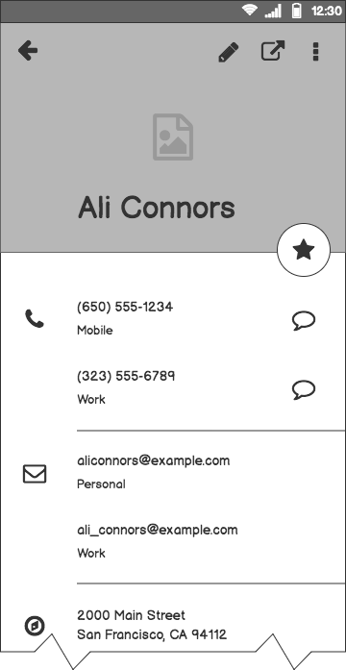
Contacts (Mobile)

Slide 21
Next Steps

Slide 22
What next?
Present the timeline.
Solicit comments on these slides or reviews on these wireframes in the Balsamiq add-on.
User testing plan.

Slide 23
Timeline
MAY
JUN
TODAY
AUG
SEPT
OCT
NOV
Requirements gathering
User research
Wireframes
Review
Prototype
User testing
Dev hand-off

Slide 24
Questions?

Slide 25
References
Tips for Presenting Your Wireframes
3 Steps to Better UI Wireframes
Wireframing for Beginners

